Slide 1

Prediction of
Log P
Chu Xian Liang
Ong Jaymee
Tiffany Tay Ting Ting

Slide 2
Contents
01.
Introduction of Paper
02.
Our Project
Notes:
Before we go straight into our project, let's take a look what has been done.

Slide 3
Introduction
Aim: To investigate the correlation between partition coefficient (Log P) and physico-chemical descriptors for a large data set of compounds.

Slide 4
Introduction
Aim: To investigate the correlation between partition coefficient (Log P) and physico-chemical descriptors for a large data set of compounds.
Log P: The ratio of concentrations of a compound in a mixture of two immiscible solvents at equilibrium.
Its values are vital to drug discovery and other chemical research.
Notes:
partition coefficient measures how hydrophilic ("water-loving") or hydrophobic ("water-fearing") a chemical substance is.

Slide 5
Introduction
Aim: To investigate the correlation between partition coefficient (Log P) and physico-chemical descriptors for a large data set of compounds.
Log P: The ratio of concentrations of a compound in a mixture of two immiscible solvents at equilibrium.
Its values are vital to drug discovery and other chemical research.
Models used:
Support Vector Machine (R2 = 0.92)
Radial Basis Function Neural Network (R2 = 0.90)
Multiple Linear Regression (R2 =0.88)

Slide 6
Introduction
Aim: To investigate the correlation between partition coefficient (Log P) and physico-chemical descriptors for a large data set of compounds.
Log P: The ratio of concentrations of a compound in a mixture of two immiscible solvents at equilibrium.
Its values are vital to drug discovery and other chemical research.
Models used:
Support Vector Machine (R2 = 0.92)
Radial Basis Function Neural Network (R2 = 0.90)
Multiple Linear Regression (R2 =0.88)
Notes:
Performance of svm was the best

Slide 7
Our project
1
2
3
4
5
Hyperparameter Tuning
Data Loading
Data Visualization & Pre-processing
Re-run the Models
Training the Models

Slide 8
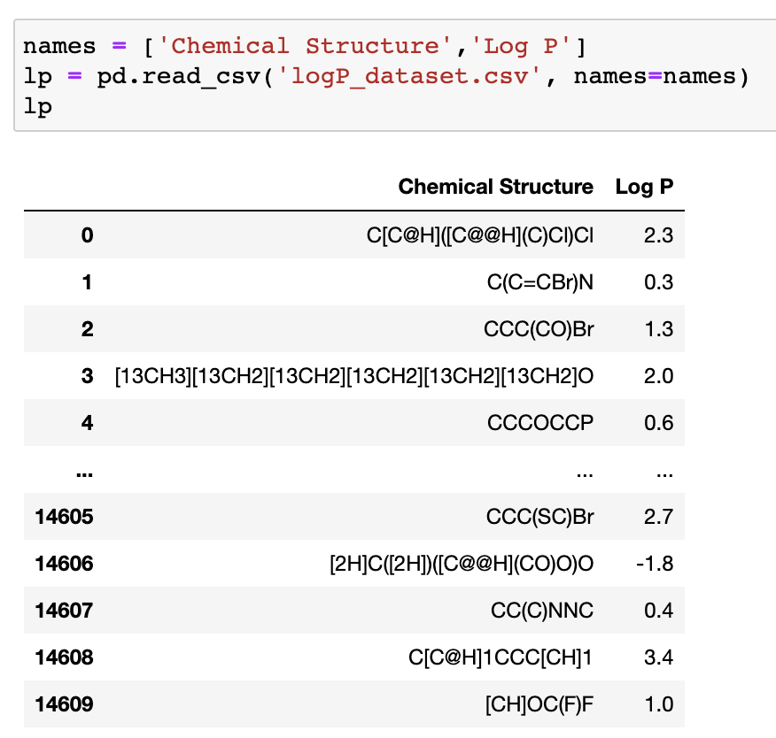
Data Loading
Rows: 14610
Columns: 2

Slide 9
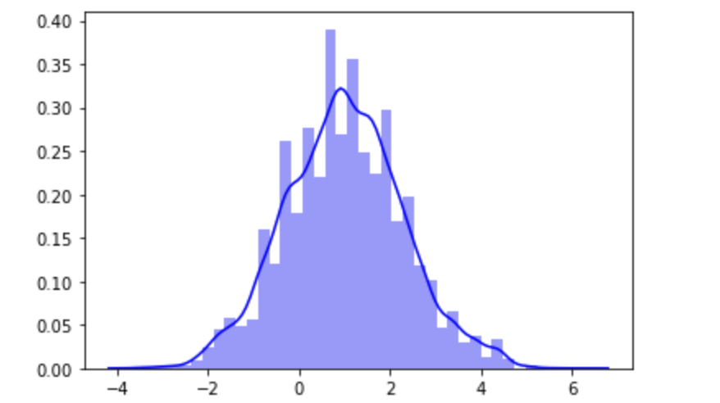
Data Visualization
Distribution of Log P values
Follows a normal distribution
Unimodal
Not skewed

Slide 10
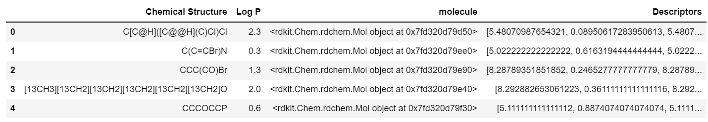
Generation of descriptors

Slide 11
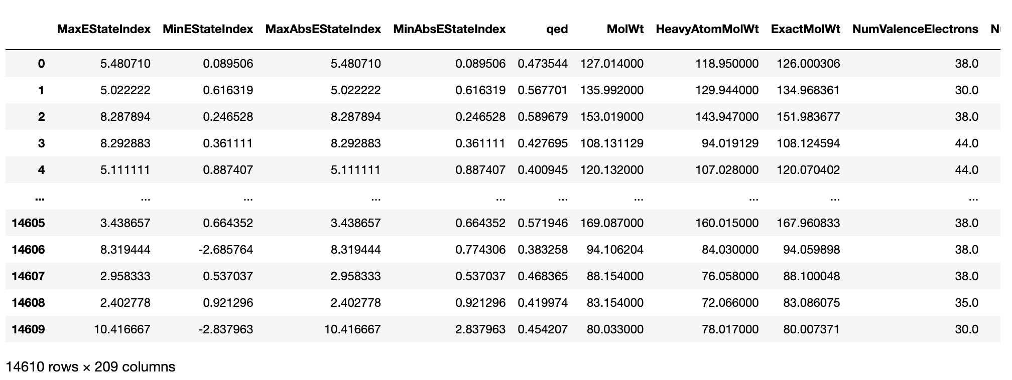
Selection of descriptors
Create a dataframe

Slide 12
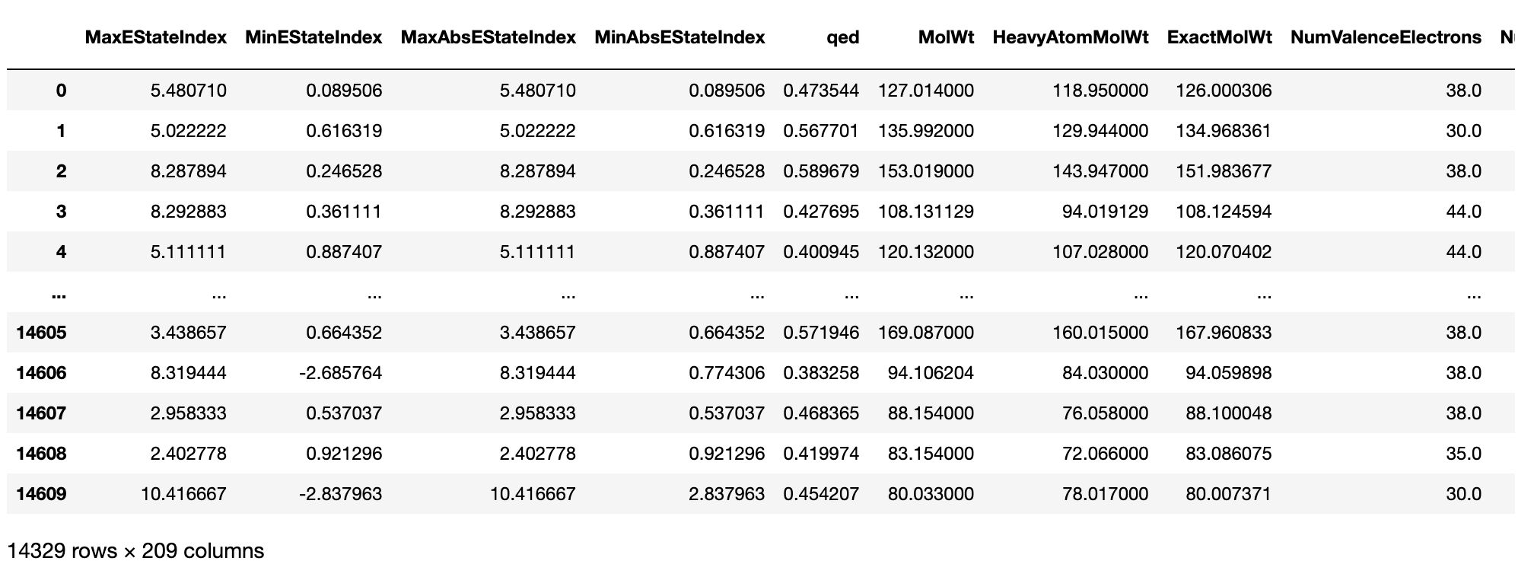
Selection of descriptors
Drop null values
Create a dataframe
Drop null values

Slide 13
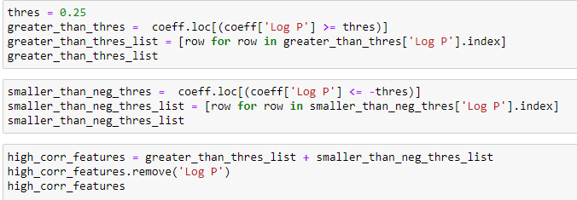
Selection of descriptors
Create a dataframe
Drop null values
Select descriptors for model
Initial: Threshold (correlation coefficient) was set to +/- 0.8
Accuracy was low, poor prediction
Threshold was set to be +/- 0.25
Notes:
After which we can selection our descriptors. Heres our code showing how we the selection. Basically, its based on the correlation coefficients. Initially the threshold was pos or neg 0.8 however when we train using tht set of features the accuracy was rather low for most models. We then reduced to 0.6 and 0.5 so that the features selected are significantly correlated. However, the accuracy was still low for most models. Hence, we further reduced it and realised that the accuracy was btr and in fact quite good. The reason could be becus even tho the features were not significantly correlated to log P, they maybe correlated to each other, hence resulting in like additive effect or it could be becus certain features, tho poorly correlated however, still important for predicting log P. thus, the threshold was set to be +/-0.25. So in total, we have 46 features tht were included for our models. Before we look at the different models trained, here’s the dataset tht was used for training our models.

Slide 14
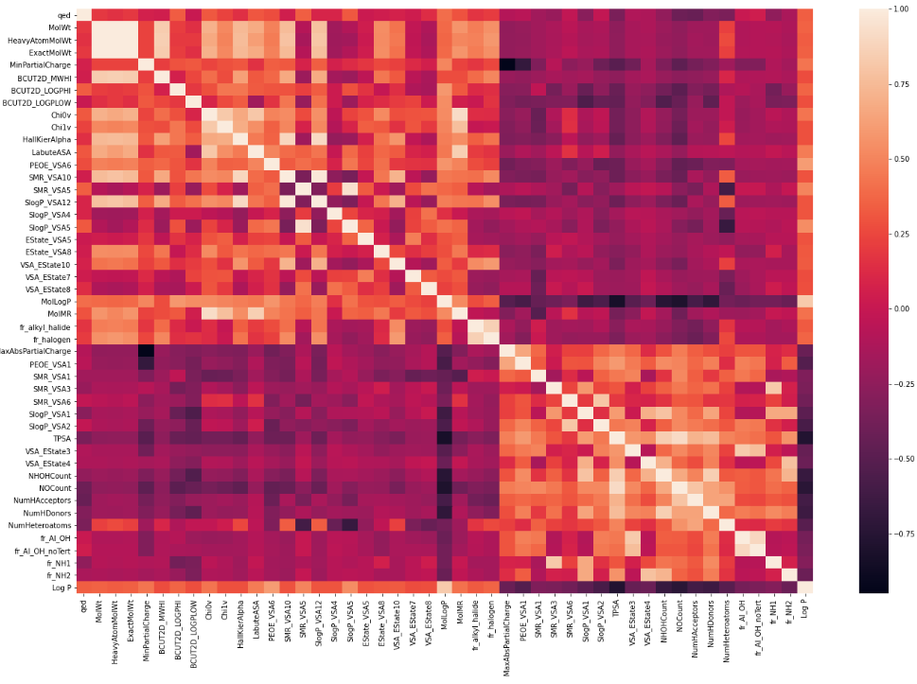
Correlation Plot
46 features

Slide 15
Dataset for training the models
Dataset
Data Pre-processing
Split Data
X: 46 features
Y: Log P
Training features (X) were pre-processed to zero mean and unit variance
Train: 10746
Test: 3583

Slide 16
Training the model
Models used:
Linear
Ridge, Lasso
Support Vector Regression (SVR)
K-Nearest Neighbors Regression (kNN)
Gradient Boosting
Decision Tree
Random Forest
Simple Neural Network
Radial Basis Function Neural Network (RBFNN)

Slide 17
Training the model
Models used:
Linear
Ridge, Lasso
Support Vector Regression (SVR)
K-Nearest Neighbors Regression (kNN)
Gradient Boosting
Decision Tree
Random Forest
Simple Neural Network
Radial Basis Function Neural Network (RBFNN)
Basic Machine Learning

Slide 18
Training the model
Models used:
Linear
Ridge, Lasso
Support Vector Regression (SVR)
K-Nearest Neighbors Regression (kNN)
Gradient Boosting
Decision Tree
Random Forest
Simple Neural Network
Radial Basis Function Neural Network (RBFNN)
Basic Machine Learning
Deep Learning

Slide 19
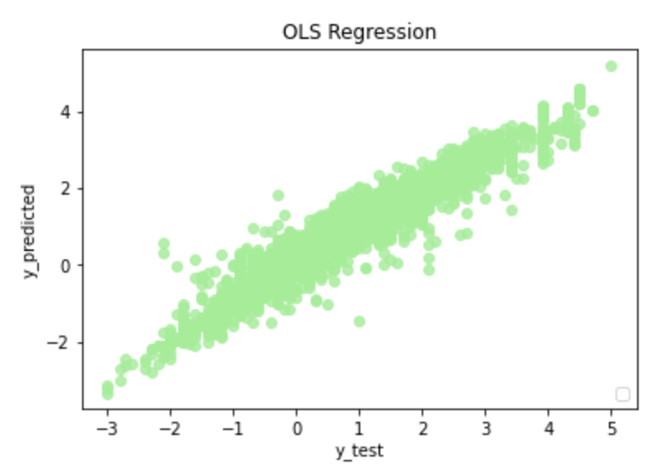
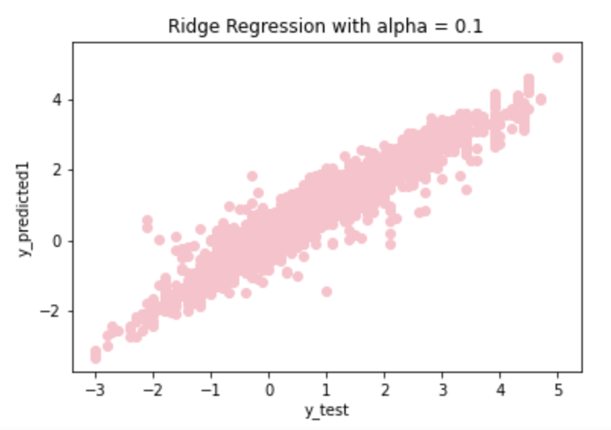
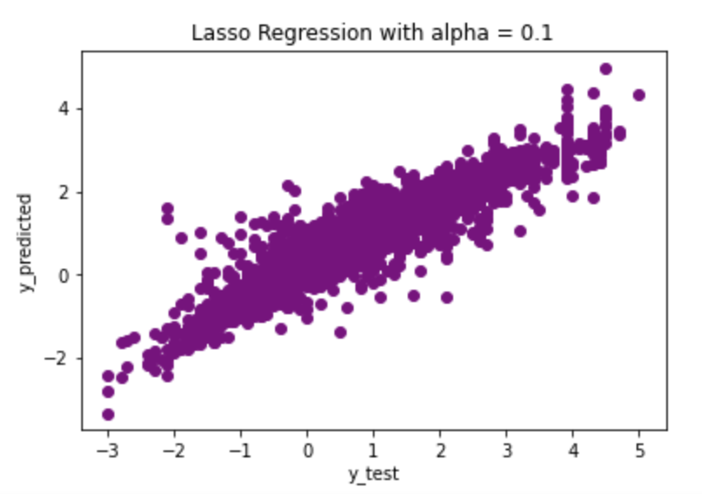
Results before tuning
 | Linear | Ridge | Lasso
R2 Scores | 0.919 | 0.919 | 0.844
MSE Scores | 0.134 | 0.134 | 0.258

Slide 20
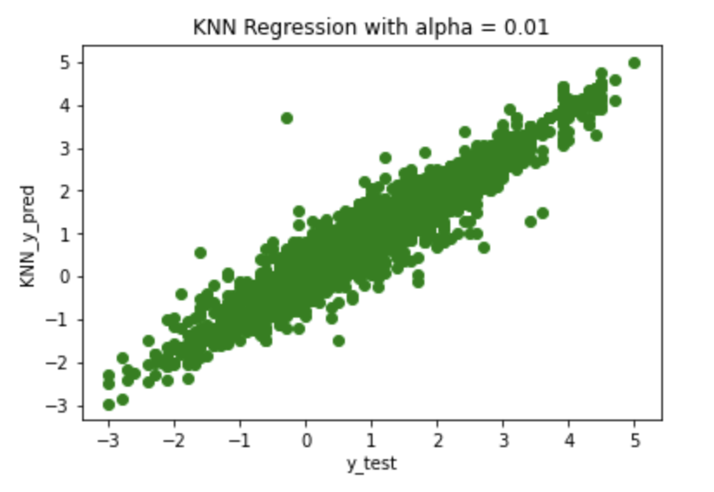
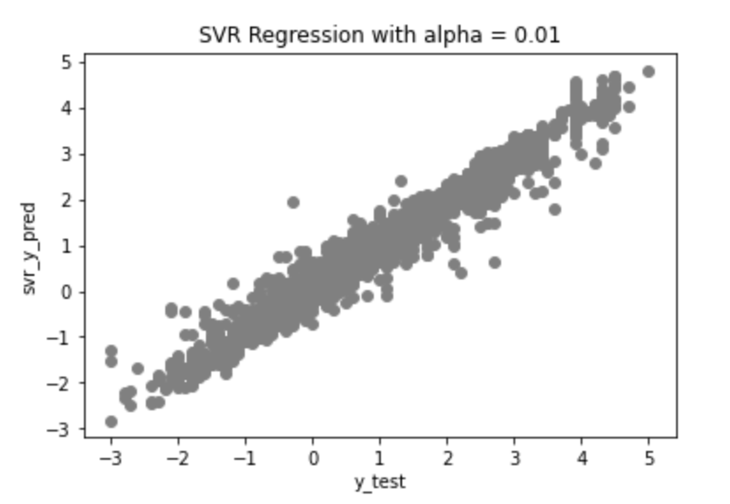
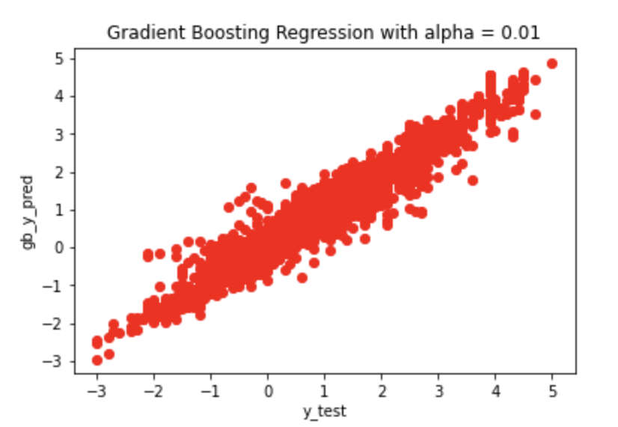
Results before tuning
 | KNN | SVR | Gradient Boosting
R2 Scores | 0.926 | 0.960 | 0.934
MSE Scores | 0.122 | 0.067 | 0.109

Slide 21
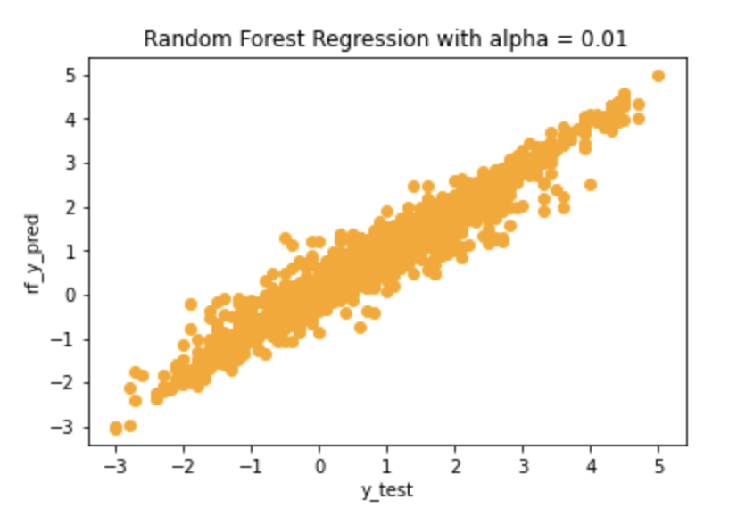
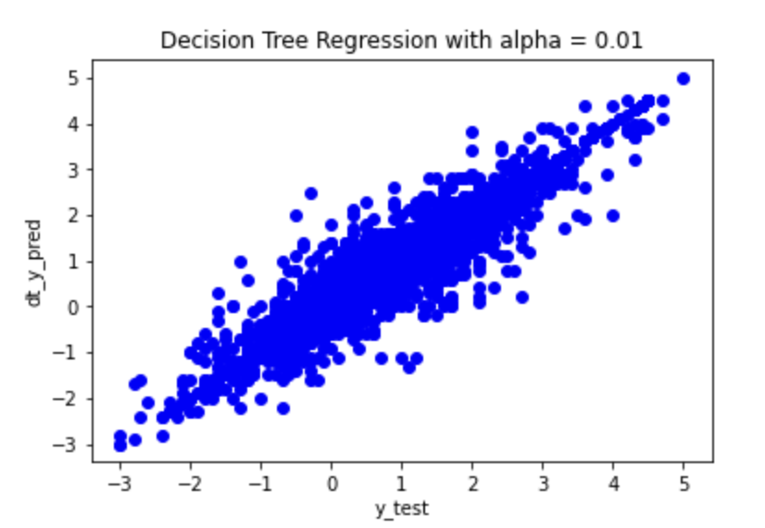
Results before tuning
 | Random Forest | Decision Tree
R2 Scores | 0.957 | 0.904
MSE Scores | 0.072 | 0.159

Slide 22
Results before tuning
Algorithms | R2 Scores | MSE Scores
Linear Regression | 0.919 | 0.134
Ridge Regression | 0.919 | 0.134
Lasso Regression | 0.844 | 0.258
kNN Regression | 0.926 | 0.122
Support Vector Regression | 0.960 | 0.067
Random Forest Regression | 0.957 | 0.072
Decision Tree Regression | 0.904 | 0.159
Gradient Boosting Regression | 0.934 | 0.109

Slide 23
Grid search vs Random search
Algorithms | Grid Search | Random Search
Support Vector Regression | 0.967 | 0.967
Random Forest Regression | 0.953 | 0.953
Decision Tree Regression | 0.892 | 0.891
Gradient Boosting Regression | 0.956 | 0.956
Conclusion: Random search takes a shorter time but both methods yield similar results

Slide 24
Results
Algorithms | Before Tuning |  | After Tuning
 | R2 Scores | MSE Scores | R2 Scores | MSE Scores
Linear Regression | 0.919 | 0.134 | -
Ridge Regression | 0.919 | 0.134 | 0.919 | 0.134
Lasso Regression | 0.844 | 0.258 | 0.907 | 0.154
kNN Regression | 0.926 | 0.122 | 0.929 | 0.117
Support Vector Regression | 0.960 | 0.067 | 0.963 | 0.061
Random Forest Regression | 0.957 | 0.072 | 0.957 | 0.071
Decision Tree Regression | 0.904 | 0.159 | 0.902 | 0.163
Gradient Boosting Regression | 0.934 | 0.109 | 0.961 | 0.065

Slide 25
Results
Algorithms | Before Tuning |  | After Tuning
 | R2 Scores | MSE Scores | R2 Scores | MSE Scores
Linear Regression | 0.919 | 0.134 | -
Ridge Regression | 0.919 | 0.134 | 0.919 | 0.134
Lasso Regression | 0.844 | 0.258 | 0.907 | 0.154
kNN Regression | 0.926 | 0.122 | 0.929 | 0.117
Support Vector Regression | 0.960 | 0.067 | 0.963 | 0.061
Random Forest Regression | 0.957 | 0.072 | 0.957 | 0.071
Decision Tree Regression | 0.904 | 0.159 | 0.902 | 0.163
Gradient Boosting Regression | 0.934 | 0.109 | 0.961 | 0.065

Slide 26
Results
Algorithms | Before Tuning |  | After Tuning
 | R2 Scores | MSE Scores | R2 Scores | MSE Scores
Linear Regression | 0.919 | 0.134 | -
Ridge Regression | 0.919 | 0.134 | 0.919 | 0.134
Lasso Regression | 0.844 | 0.258 | 0.907 | 0.154
kNN Regression | 0.926 | 0.122 | 0.929 | 0.117
Support Vector Regression | 0.960 | 0.067 | 0.963 | 0.061
Random Forest Regression | 0.957 | 0.072 | 0.957 | 0.071
Decision Tree Regression | 0.904 | 0.159 | 0.902 | 0.163
Gradient Boosting Regression | 0.934 | 0.109 | 0.961 | 0.065

Slide 27
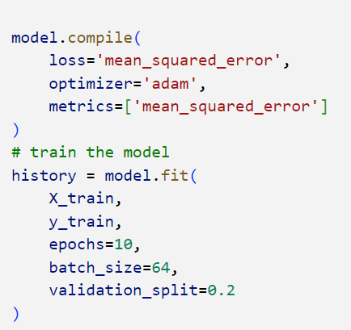
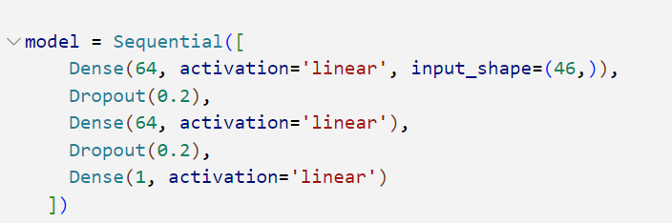
Simple Neural Network
Original Model
3 Dense layers & 2 Dropout layers
64 neurons in input and hidden layer
Epochs = 10
Batch Size = 64

Slide 28
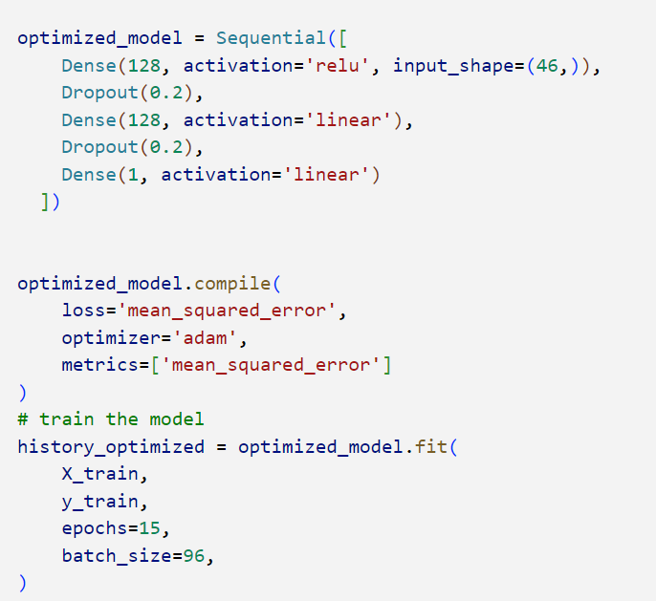
Simple Neural Network
Optimized Model
Input layer: Linear -> ReLU
Increase number of neurons to 128
Increase epochs to 15
Increase Batch_size to 96

Slide 29
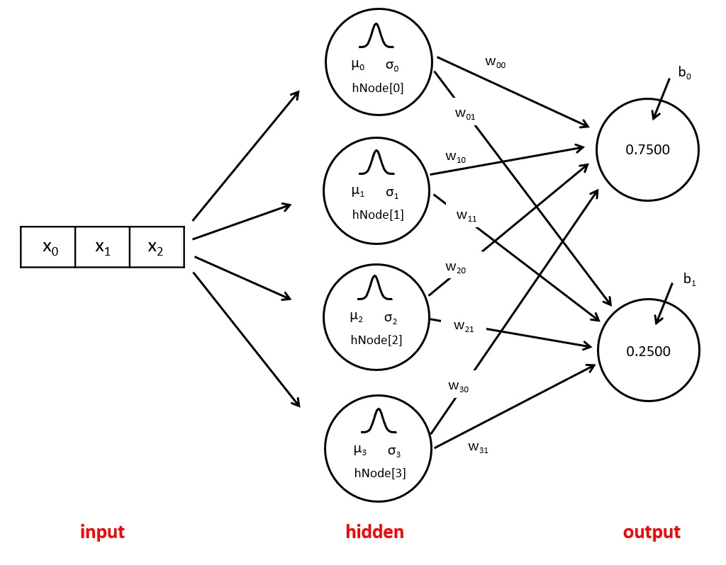
RBFNN - Overview
A feed-forward neural network
Input, hidden, output
Hidden layer consists of RBF, which is a non-linear transfer function
Gaussian function most commonly used

Slide 30
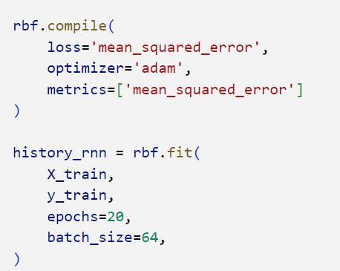
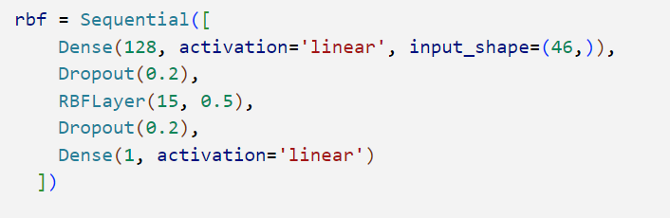
RBFNN
Original Model:
2 Dense layers (Input, Output)
1 RBF layer
2 Dropout layers
Epochs = 20
Batch size = 64

Slide 31
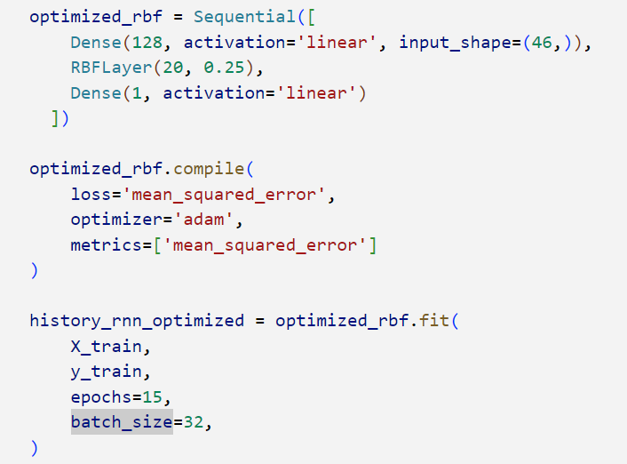
RBFNN
Optimized Model:
RBF layer - neurons increased to 20
Removed dropout
Gamma changed to 0.25
Epochs decreased to 15
Batch size decreased to 32

Slide 32
Results
Algorithms | Before Tuning |  | After Tuning
 | R2 Scores | MSE Scores | R2 Scores | MSE Scores
Linear Regression | 0.919 | 0.134 | -
Ridge Regression | 0.919 | 0.134 | 0.919 | 0.134
Lasso Regression | 0.844 | 0.258 | 0.907 | 0.154
kNN Regression | 0.926 | 0.122 | 0.929 | 0.117
Support Vector Regression | 0.960 | 0.067 | 0.963 | 0.061
Random Forest Regression | 0.957 | 0.072 | 0.957 | 0.071
Decision Tree Regression | 0.904 | 0.159 | 0.902 | 0.163
Gradient Boosting Regression | 0.934 | 0.109 | 0.961 | 0.065
Simple Neural Network | 0.909 | 0.151 | 0.949 | 0.084
Radial Basis Function Neural Network | 0.894 | 0.176 | 0.902 | 0.161

Slide 33
Results
Algorithms | Before Tuning |  | After Tuning
 | R2 Scores | MSE Scores | R2 Scores | MSE Scores
Linear Regression | 0.919 | 0.134 | -
Ridge Regression | 0.919 | 0.134 | 0.919 | 0.134
Lasso Regression | 0.844 | 0.258 | 0.907 | 0.154
kNN Regression | 0.926 | 0.122 | 0.929 | 0.117
Support Vector Regression | 0.960 | 0.067 | 0.963 | 0.061
Random Forest Regression | 0.957 | 0.072 | 0.957 | 0.071
Decision Tree Regression | 0.904 | 0.159 | 0.902 | 0.163
Gradient Boosting Regression | 0.934 | 0.109 | 0.961 | 0.065
Simple Neural Network | 0.909 | 0.151 | 0.949 | 0.084
Radial Basis Function Neural Network | 0.922 | 0.176 | 0.925 | 0.124

Slide 34
Results
Algorithms | Before Tuning |  | After Tuning
 | R2 Scores | MSE Scores | R2 Scores | MSE Scores
Linear Regression | 0.919 | 0.134 | -
Ridge Regression | 0.919 | 0.134 | 0.919 | 0.134
Lasso Regression | 0.844 | 0.258 | 0.907 | 0.154
kNN Regression | 0.926 | 0.122 | 0.929 | 0.117
Support Vector Regression | 0.960 | 0.067 | 0.963 | 0.061
Random Forest Regression | 0.957 | 0.072 | 0.957 | 0.071
Decision Tree Regression | 0.904 | 0.159 | 0.902 | 0.163
Gradient Boosting Regression | 0.934 | 0.109 | 0.961 | 0.065
Simple Neural Network | 0.909 | 0.151 | 0.949 | 0.084
Radial Basis Function Neural Network | 0.894 | 0.176 | 0.926 | 0.112

Slide 35

THANK YOU !

